Slide 1
Data Communications and Networking-CS44

Slide 2
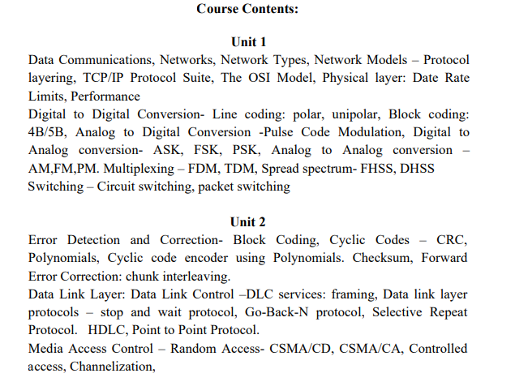
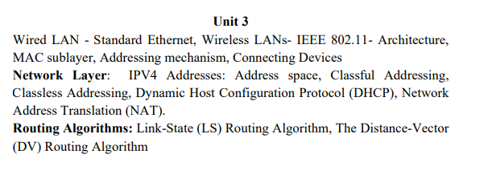
Syllabus

Slide 3
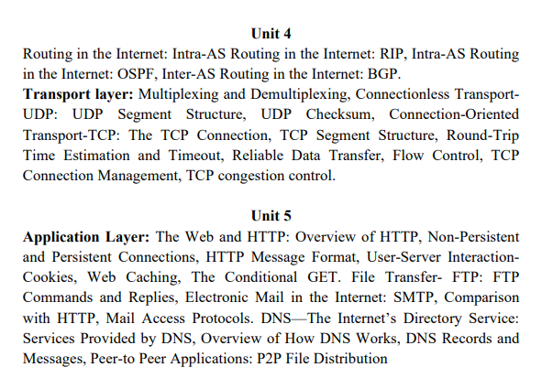

Slide 4
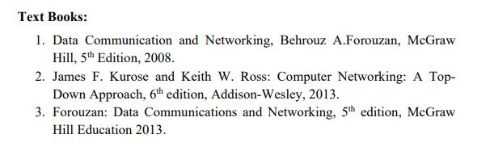

Slide 5
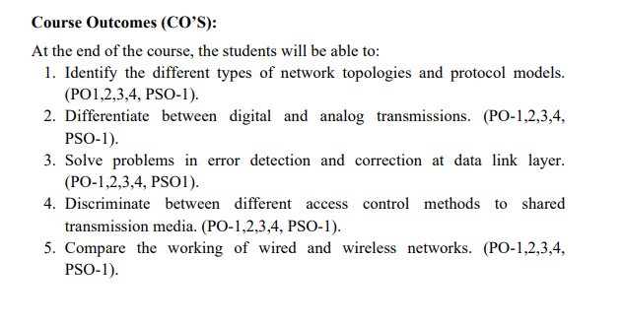

Slide 6
Outline of Session-1
DATA COMMUNICATIONS
Components
Data Representation
Data Flow
NETWORKS
Network Criteria
Physical Structures
NETWORK TYPES
Local Area Network
Wide Area Network
Switching
The Internet
Accessing the Internet

Slide 7
Telecom vs. Datacom
Communications
Transfer of data from one device to another via some form of
transmission medium
Communicate = sharing information
local (usually occurs face to face) or remote (takes place over distance)
Telecommunications (tele is Greek for “far”)
Communication over a distance by definition
All type of communications using signaling such as voice (telephone),
images (television), data (computers)
Data communications
subset of telecommunications that involves the transmission and reception of data to and from computers and components of computer systems

Slide 8
Data communications
depends on four fundamental characteristics:
Delivery: deliver data to the correct destination
Accuracy: deliver the data accurately
Timeliness: deliver data in a timely manner
Jitter: the variation in the packet arrival time
A data communications system has five components
Component | Description | Example
Message | The message is the information (data) to be communicated | Popular forms of information include text, numbers, pictures, audio, and video
Sender | the device that sends the data message | a computer, workstation, telephone handset, video camera, and so on
Receiver | the device that receives the message | Same as sender
Transmission medium | the physical path by which a message travels from sender to receiver | twisted-pair wire, coaxial cable, fiber-optic cable, and radio waves
Protocol | a set of rules that govern data communications

Slide 9







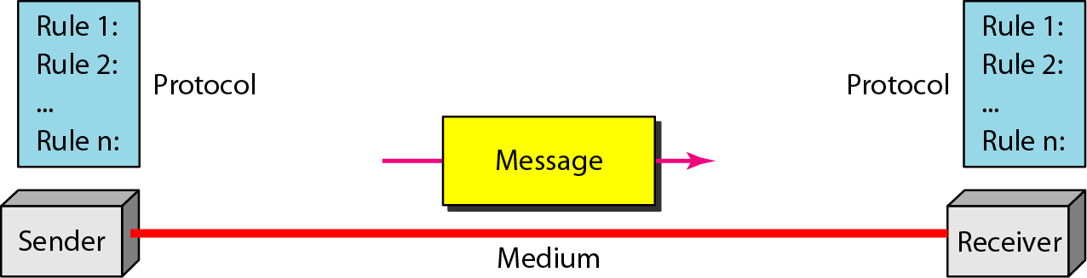
Communication Model
1
4
Source system
2
Destination system
input message
output message
Source
Device
Destination
device
3
Communications system
transmitted signal
received signal
input data
output data
5
Protocol

Slide 10
Data Representation
text is represented as a bit pattern, a sequence of bits (0s or 1s)
Different sets of bit patterns have been designed to represent text
symbols – code
the process of representing symbols is called coding.
Unicode - prevalent coding system - uses 32 bits to represent a symbol or
character used in any language in the world.
American Standard Code for Information Interchange (ASCII) developed some decades ago in the United States
constitutes the first 127 characters in Unicode and is also referred to as Basic Latin
Numbers – also represented by bit patterns
8/16/32 bit integers, signed/unsigned
floating-point
ASCII is not used to represent numbers
It is directly converted to a binary number to simplify mathematical operations.

Slide 11


Data Representation …
Images
composed of a matrix of pixels (picture elements) => each pixel is a small dot
size of the pixel depends on the resolution
More pixels in a image - a better representation of the image
(better resolution), but more memory is needed to store the image
each pixel is assigned a bit pattern
The size and the value of the pattern depend on the image
For an image made of only black and white dots (e.g., a chessboard), a 1-bit pattern
is enough to represent a pixel.
represent color images: RGB (combination of three primary colors: red, green, and blue) and YCM (combination of three other primary colors: yellow, cyan, and
magenta)
Graphics formats JPG, PNG, etc.
150
2
255

Slide 12
Data Representation …
Audio →recording or broadcasting of sound or music
Samples of continuous, not discrete signal
Audio is by nature different from text, numbers, or images.
Video → recording or broadcasting of a picture or movie
can either be produced as a continuous entity (e.g., by a TV camera), or it can be a combination of images, each a discrete entity, arranged to convey the idea of motion
Sequence of bitmap images

Slide 13
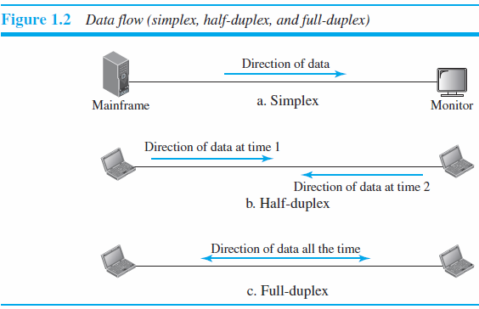



Data Flow
Direction of data flow
Type of
Direction

Slide 14












Simplex
Data are only transmitted in one direction - One device can only transmit; the
other can only receive
The simplex mode can use the entire capacity of the channel to send data in one direction.
Eg. the keyboard can only introduce input; the monitor can only accept output.
Computer
Display
Unidirectional
Hi….
Transmitter
pager

Slide 15
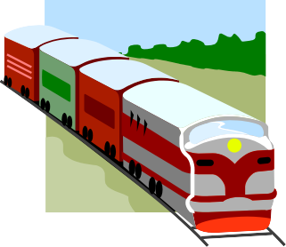


Half-duplex
Each stations can transmit or receive; but only one at a time (alternate in transmitting)
When one device is sending, the other can only receive, and vice versa
The entire capacity of a channel is taken over by whichever of the two devices is transmitting at the time
Example: Walkie-Talkies, CB (citizens band) radios
S₁
Transmit from S₁ to S₂ at time T₁
S₂
Transmit from S₂ to S₁ at time T₂
Transmitter/Receiver
Transmitter/Receiver

Slide 16


Full-duplex
Both stations can transmit and receive simultaneously
signals going in one direction share the capacity of the link with signals going in the other direction
sharing can occur in two ways:
Link with two separate transmission path, one for sending and the other for receiving
channel is divided between signals traveling in opposite directions
Example: telephone network -When two people are communicating by a telephone line, both can talk and listen at the same time
Simulteneous send and receive
S₁
data from each other
S₂
Transmitter/Receiver
Transmitter/Receiver

Slide 17
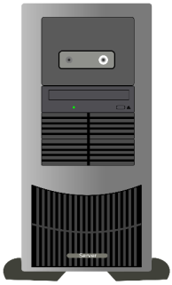


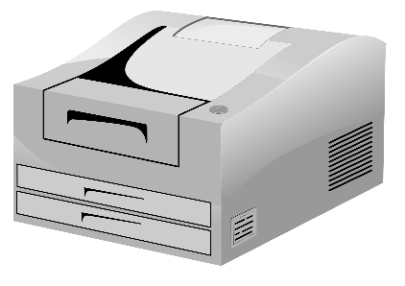
Networks
A network is a set of two or more devices connected through a communication system
A node can be a computer, printer, or any other device capable of sending and/or receiving data generated by other nodes on the network.
Communication System

Slide 18
Network Criteria
performance: measured in many ways, including transit time (amount of time required for a message to travel from one device to another ) and response time (elapsed time between an inquiry and a response)
depends on a number of factors
the number of users
the type of transmission medium
the capabilities of the connected hardware
the efficiency of the software
evaluated by two networking metrics: throughput (expected more) and delay (expected less)…………. Often contradictory
Reliability: measured in terms of
accuracy of delivery
frequency of failure
the time it takes a link to recover from a failure
Security
protecting data from unauthorized access
protecting data from damage and development
implementing policies and procedures for recovery from breaches and data losses

Slide 19

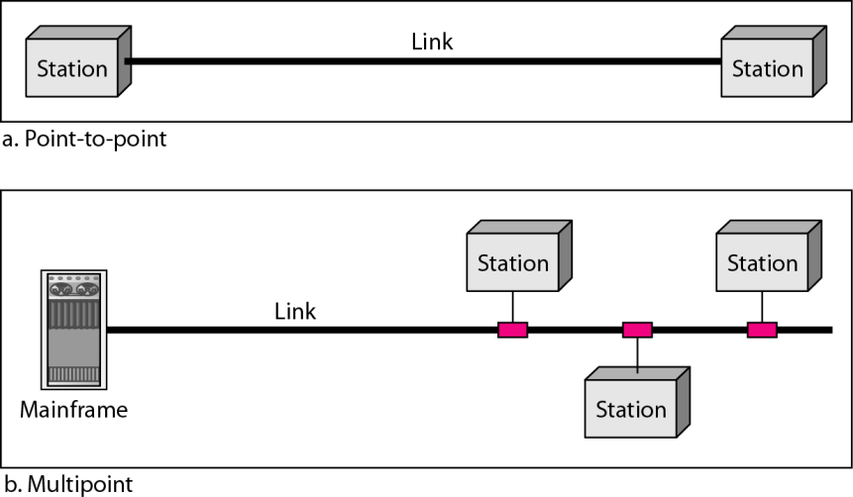







Physical Structures
Network attributes: Type of Connection and Physical Topology
For communication to occur, two devices must be connected in some way to the same link at the same time.
There are two possible types of connections: point-to-point and multipoint
Point-to-Point
Line
configurations
Multipoint

Slide 20
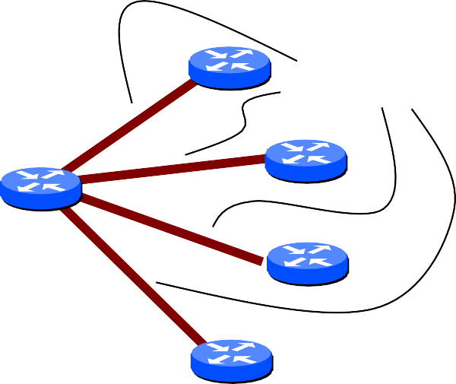


Point-to-Point
Only two devices share the medium
The entire capacity of the link is reserved for the transmission between those two devices
A direct link between two devices
A direct link
between two devices
Station
Station

Slide 21




Multipoint (or Multidrop)
More than two devices share the same medium
The capacity of the link is shared, either spatially (use the link simultaneously )or temporally (users must take turns)
Station
Station
Station
A link is shared between several devices
Station
Station

Slide 22

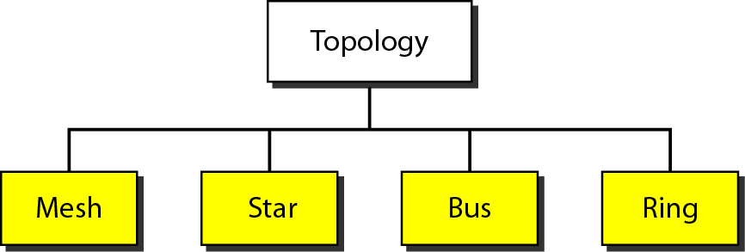

Physical Topology
the way in which a network is laid out physically
Network topology: geometric representation of the relationship of all the links and linking devices (usually called nodes) to one another
Common Network
Topologies

Slide 23
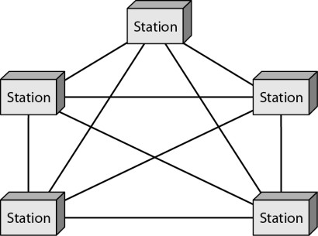
Mesh Topology - point-to-point
every device has a dedicated point-to-point link to every other device
number of physical links in a fully connected mesh network with n nodes : n (n – 1) physical links or n (n – 1) / 2
duplex-mode links
every device on the network must have n – 1 input/output (I/O) ports to be connected to the other n – 1 stations

Slide 24
Mesh Topology
Advantages
They use the dedicated links so each link can only carry its own data load – traffic problem can be avoided
It is robust – if one link get damaged, it cannot affect others
It gives privacy and security (message travels along a dedicated link)
Fault identification and fault isolation are easy
Disadvantages
The amount of cabling and the number of I/O ports required are very large.
because every device must be connected to every other device, installation and reconnection are difficult
The sheer bulk of wiring is larger than the available space
Hardware required to connect each device is highly expensive.
Applications
connection of telephone regional offices - each regional office needs to be connected to every other regional office
WAN – wide area network

Slide 25
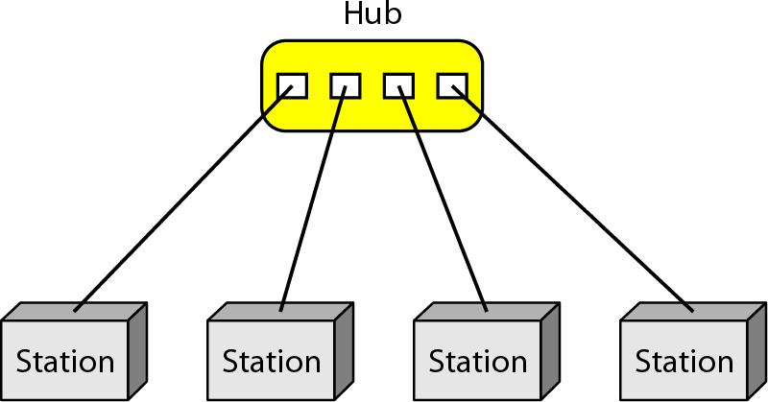
Star Topology - point-to-point
Each device has a dedicated point to point link to the central controller called “Hub” – act as a exchange
There is no direct traffic between devices
The transmission are occurred only through the central hub
When device 1 wants to send data to device 2 –first sends the data to hub which then relays the data to the other connected device

Slide 26
Star Topology
Advantages
Less expensive than mesh since each device is connected only to
the hub
each device needs only one link and one I/O port to connect it to any number of others
Installation and configuration are easy
Less cabling is needed than mesh
additions, moves, and deletions involve only one connection: between that device
and the hub
Robustness - if one link fails only that link is affected – all other
links remain active
Easy to fault identification and to remove parts
No disruptions to the network when connecting or removing the devices

Slide 27
Star Topology
Disadvantage
dependency of the whole topology on one single point, the hub. If
the hub goes down, the whole system is dead
often more cabling is required in a star than in some other
topologies (such as ring or bus).
Applications
local-area networks (LANs)
High-speed LANs

Slide 28
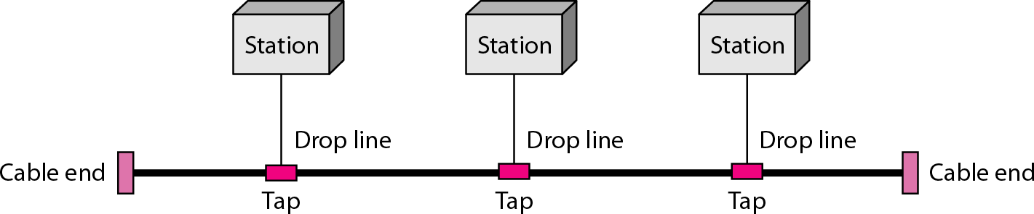
Bus Topology - multipoint
One long cable acts as a backbone to link all the devices in a network
Nodes are connected to the bus cable by drop lines and taps
drop line - a connection running between the device and the main cable
tap – splitter that cut the main link to create a contact with the metallic core
Allows only one device to transmit at a time

Slide 29
Bus Topology
A device want to communicate with other device on the network sends a broadcast message onto the wire and all other devices see
But only the intended device accepts and process the message
As a signal travels along the backbone, some of its energy is transformed into heat - it becomes weaker and weaker as it travels farther and farther
For this reason there is a limit on the number of taps a bus can
support and on the distance between those taps

Slide 30
Bus Topology
Advantages
ease of installation
less cabling than mesh or star topologies
Only the backbone cable stretches through the entire facility
Each drop line has to reach only as far as the nearest point on the backbone.
Disadvantages
difficult reconnection and fault isolation
A bus is usually designed to be optimally efficient at installation - difficult to add
new devices
Adding new devices may therefore require modification or replacement of the backbone
Signal reflection at the taps can cause degradation in quality
controlled by limiting the number and spacing of devices connected to a given length of cable
a fault or break in the bus cable stops all transmission -The damaged area
reflects signals back in the direction of origin, creating noise in both directions
Applications
design of early local area networks
Most of computer motherboards

Slide 31
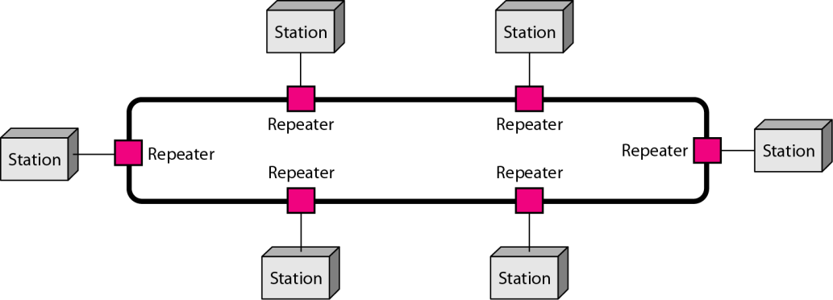
Ring Topology – point-to-point
each device has a dedicated point-to-point connection with only the two devices on either side of it
A signal is passed along the ring in one direction, from device to device, until it reaches its destination
Each device in the ring incorporates a repeater
When a device receives a signal intended for another device, its repeater regenerates the bits and passes them along

Slide 32
Ring Topology
Advantages
relatively easy to install and reconfigure
To add or delete a device requires changing only two connections - only constraints are media and traffic considerations (maximum ring length and number of devices
fault isolation is simplified
As a signal is circulating at all times, non reception of a signal at a node within a specified period issue an alarm from that node - alerts the network operator to the problem and its location
Disadvantage
unidirectional traffic
a break in the ring (such as a disabled station) can disable the entire network -
solved by using a dual ring or a switch capable of closing off the break
Applications
prevalent when IBM introduced its local-area network, Token Ring
Some office buildings and School premises
higher-speed LANs has made this topology less popular

Slide 33
Consideration for choosing the topology
Money: bus network is the least expensive way to install network
Length: of cable needed the linear bus network uses shorter length of cable
Future growth: with start topology expending a network is easily done by adding another devices
Cable type: most common used cable in commercial organization is twisted pair which often used with star topologies

Slide 34
Network Types
The criteria of distinguishing one type of network from another in the world today (difficult and sometimes confusing)
Size
geographical coverage
ownership.
two types of networks, LANs and WANs, uses switching to connect networks to form an internetwork (a network of networks)

Slide 35
Local Area Network
usually privately owned
connects some hosts in a single office, building, or campus
Simple LAN - two PCs and a printer in someone’s home office
Complex LAN include audio and video devices
An host identifier (an address) uniquely defines the host in the LAN
A packet carries both the source host’s and the destination host’s addresses

Slide 36




















LAN
hub/switch
stations
General Characteristics :
Confined geographical area
Under single management
High data rate
hub/switch
stations
hub/switch
stations
servers
hub/switch
router

Slide 37
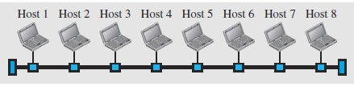
LAN with Common Cable (past)
All hosts in a network were connected through a common cable
A packet sent from one host to another was received by all hosts
The intended recipient kept the packet; the others dropped the packet
When LANs were used in isolation, they were designed to allow resources to be shared between the hosts

Slide 38
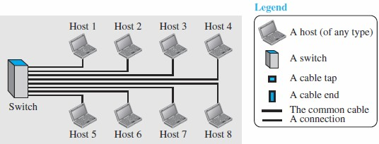
LAN with Switch
Today, most LANs use a smart connecting switch
Job of switch:
recognize the destination address of the packet
guide the packet to its destination without sending it to all other hosts.
The switch alleviates the traffic in the LAN
allows more than one pair to communicate with each other at the same time if there is no common source and destination among them
LAN does not define the minimum or maximum number of hosts in it

Slide 39
Wide Area Network
an interconnection of devices capable of communication
LAN | WAN
Normally limited in size, spanning an office, a building, or a campus | a wider geographical span, spanning a town, a state, a country, or even the world
interconnects hosts | interconnects connecting devices such as switches, routers, or modems
normally privately owned by the organization that uses it | normally created and run by communication companies and leased by an organization that uses it.
Two types: Multipoint LAN and switched LAN | Two types: point-to-point WANs, switched WANs and internetwork

Slide 40





















WAN
A network that covers a relatively broad geographic area
It often uses long-distance transmission facilities provided by public carriers

Slide 41
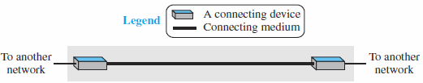
Point-to-Point WAN
connects two communicating devices through a transmission media (cable or air)

Slide 42
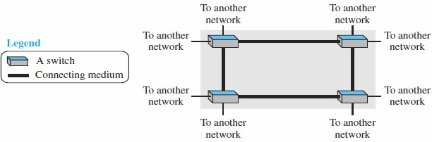
Switched WAN
a network with more than two ends
used in the backbone of global communication today
a combination of several point-to-point WANs that are connected by switches

Slide 43
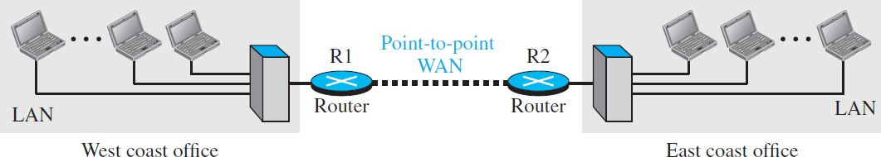
Internetwork
Isolated LAN or WAN – rare
LAN and WAN are connected to one another
internetwork, or internet: connection between two or more networks
Ex: organization with two offices, one on the east coast and the other on the west coast.
Each office has a LAN that allows all employees in the office to
communicate with each other
Communication between employees at different offices possible: the management leases a point-to-point dedicated WAN from a service provider, such as a telephone company, and connects the two LANs

Slide 44
Internetwork …
When a host in the west coast office sends a message to another host in the same office, the router blocks the message, but the switch directs the message to the destination.
When a host on the west coast sends a message to a host on the east coast, router R1 routes the packet to router R2, and the packet reaches the destination

Slide 45
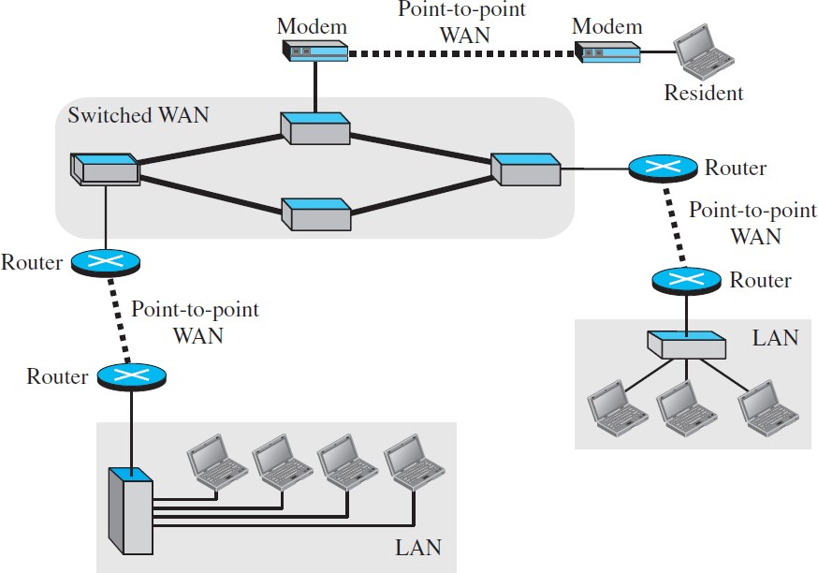
Internetwork …
A heterogeneous network made of four WANs and three LANs
One of the WANs is a switched WAN with four switches

Slide 46
Switched Network
switched network - a switch connects at least two links together
A switch forward data from a network to another network when required
The two most common types of switched networks
circuit-switched
packet-switched networks.

Slide 47



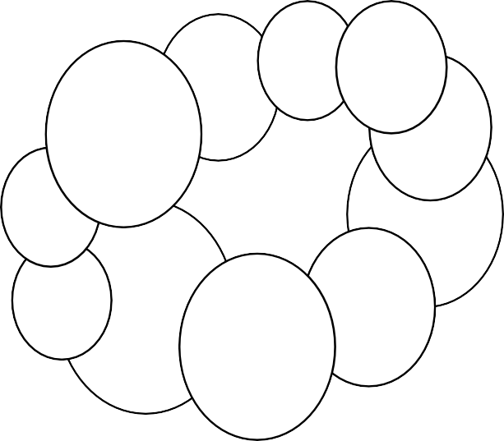








Switching
Communication Network Node
provide switching facility (routing)
Network Station
end node (source &destination)
Communications is achieved by transmitting data from source to destination through a network of switching nodes

Slide 48
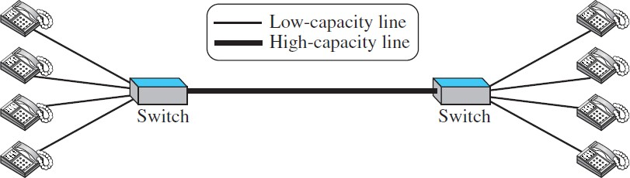
Circuit-Switched Network
a dedicated connection, called a circuit,
always available between the two end systems
the switch can only make it active or inactive
simple switched network that connects four telephones to each end
Telephone sets are shown instead of computers as an end system because circuit switching was very common in telephone networks in the past
part of the telephone network today is a packet-switched network.

Slide 49
Circuit-Switched Network
Case1: all telephone sets are busy
4-people at one site are talking with 4-people at the other site
the capacity of the thick line is fully used
Case 2: only one telephone set at one side is connected to a telephone set at the other side
only one-fourth of the capacity of the thick line is used
Circuit-switched network is efficient only when it is working at its full capacity
most of the time, it is inefficient because it is working at partial capacity
Capacity of the thick line four times the capacity of each voice line so the communication not fail when all telephone sets at one side want to be connected with all telephone sets at the other side

Slide 50
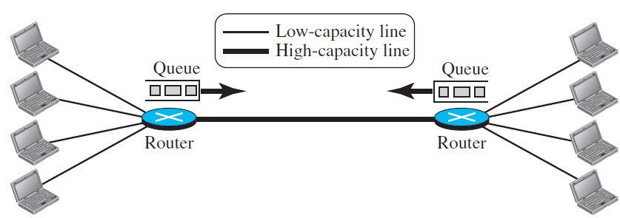
Packet-Switched Network
computer network communication between the two ends - blocks of data called packets
switches function for both storing and forwarding because a packet is an independent entity that can be stored and sent later
small packet-switched network that connects four computers at one site to four computers at the other site.

Slide 51
Packet-Switched Network
A router in a packet-switched network has a queue that can store and forward the packet
Capacity of the thick line is only twice the capacity of the data line connecting the computers to the routers
If only two computers (one at each site) need to communicate with each other, there is no waiting for the packets.
However, if packets arrive at one router when the thick line is already working at its full capacity, the packets should be stored and forwarded in the order they arrived
packet-switched network is more efficient than a circuit switched network, but the packets may encounter some delays

Slide 52









Switching Technologies
Circuit switching
A circuit is established for the two
parties
telephone switch
Packet switching
Data are put into packets, each stamped with source and destination addresses
Routers know where to forward packets
Packet
Router

Slide 53
Key Differences
Aspect | Circuit Switching | Packet Switching
Data path | Dedicated single route | Different shared routes
Message | Bypass | Temporarily stored at each node
End point's status | Both must be ready | Only sender is ready
Utilization | Poor | Good
Data rate | Fixed | Varied
Prioritization | Not support | Support

Slide 54
Session-1 Summary
Data communications are the transfer of data from one device to another via some form of
transmission medium
A data communications system must transmit data to the correct destination in an accurate
and timely manner.
The five components that make up a data communications system are the message, sender, receiver, medium, and protocol.
Text, numbers, images, audio, and video are different forms of information.
Data flow between two devices can occur in one of three ways: simplex, half-duplex, or full-
duplex.
A network is a set of communication devices connected by media links.
In a point-to-point connection, two and only two devices are connected by a dedicated link.
In a multipoint connection, three or more devices share a link.
Topology refers to the physical or logical arrangement of a network.
Devices may be arranged in a mesh, star, bus, or ring topology.

Slide 55
Summary…
A network can be categorized as a local area network or a wide area network
LAN is a data communication system within a building, plant, or campus, or between nearby buildings
WAN is a data communication system spanning states, countries, or the whole world
An internet is a network of networks

Slide 56
Educational tool for computer network
many programs and utilities available for Windows and UNIX operating systems that allow us to sniff, capture, trace, and analyze packets that are exchanged between our computer and the Internet
Some of these
Wireshark and Ping-Plotter, have graphical user interface (GUI)
others, such as traceroute, nslookup, dig, ipconfig, and ifconfig,
are network administration command-line utilities

Slide 57
Homework
Prepare the answers for Chapter 1 Section 1.7
Questions from Q1-1 to Q1-15
Problems rom P1-1 to P1-10

